Slide 1



Water Tank
Special Use Permit Request
WSUP19-0021

Slide 2
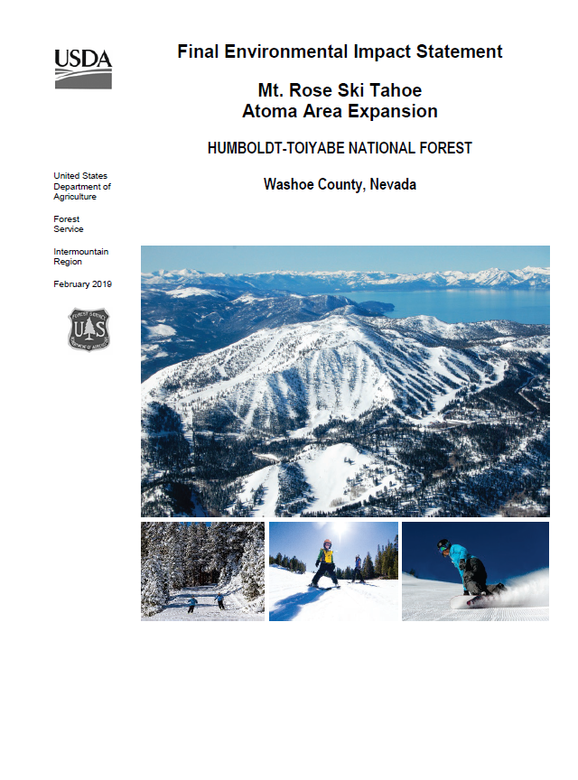
Forest Service and Environmental Review
The Mt. Rose Ski Tahoe Atoma Area Expansion has been in
The federal review process since 2011 and is nearing completion
One of the requirement of any federal review process is that all
applicable state and local permits are obtained for the project.

Slide 3
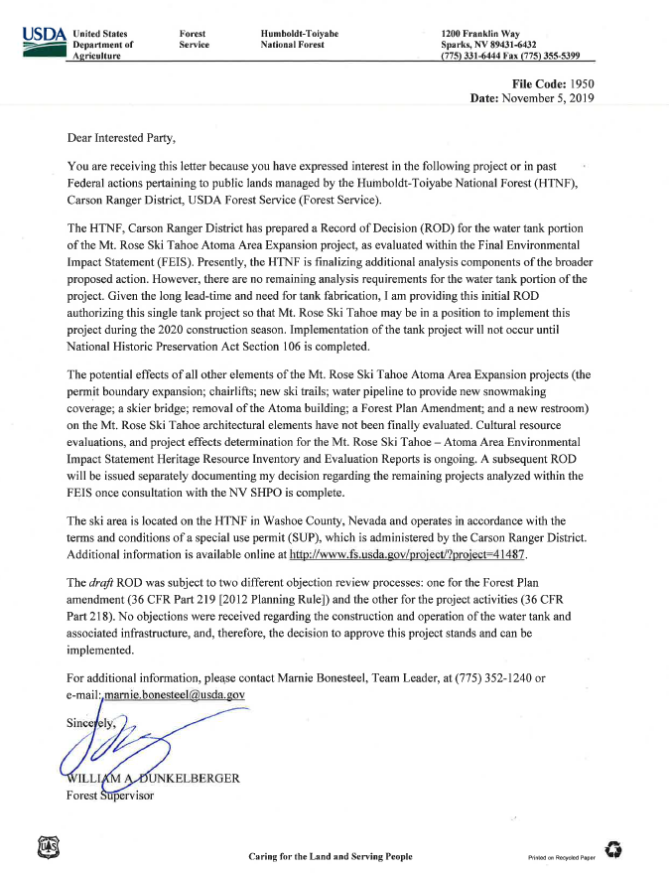
Record of Decision for Water Tank
On November 5, 2019, the USFS provided a record of decision in association with the proposed water tank as this is the improvement included in the NEPA document that is desired to be constructed first

Slide 4
Special Use Permit Request
WSUP19-0021 – Water Tank
5M Gallon Water Tank
Grading Setback and Landscape modifications
Project exists on USFS land near the existing 0.5 M gallon water tank currently used for snow making.

Slide 5
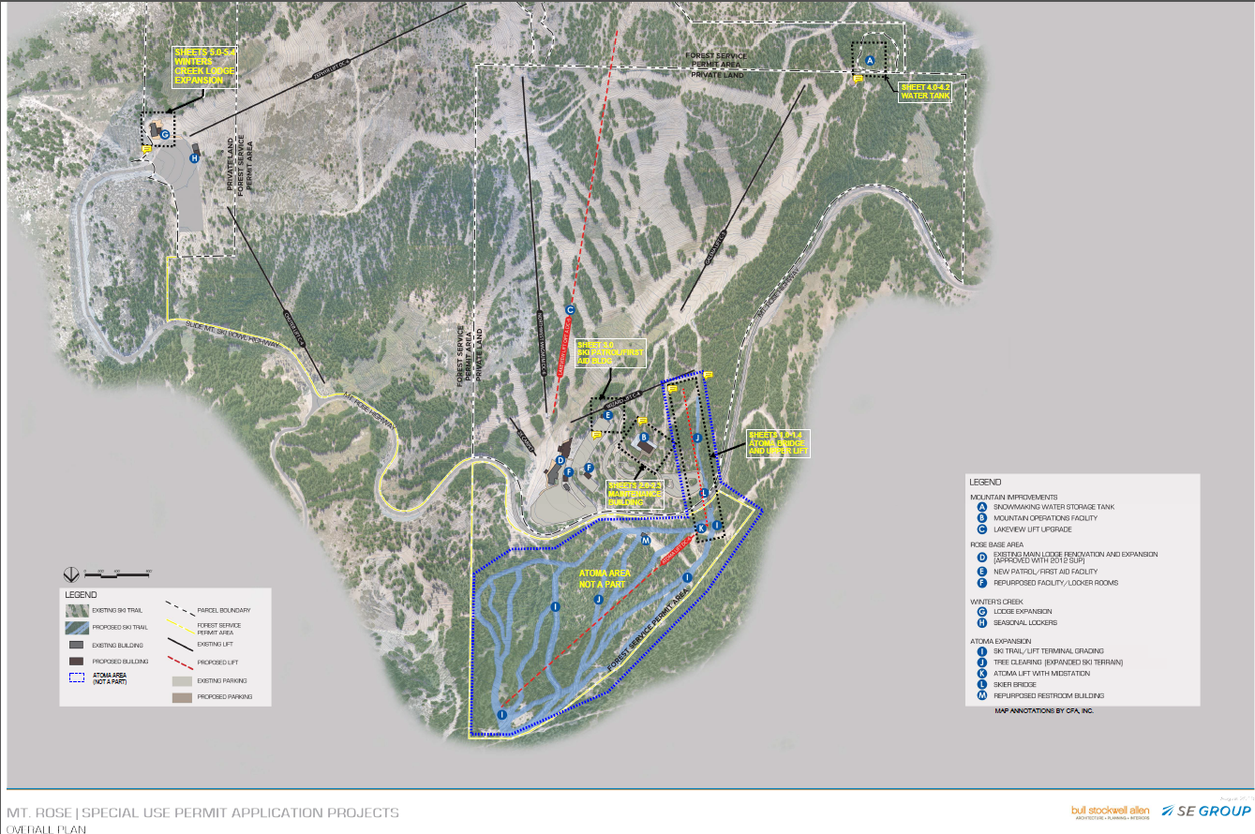
Project
Overview
5M Gal Water Tank

Slide 6
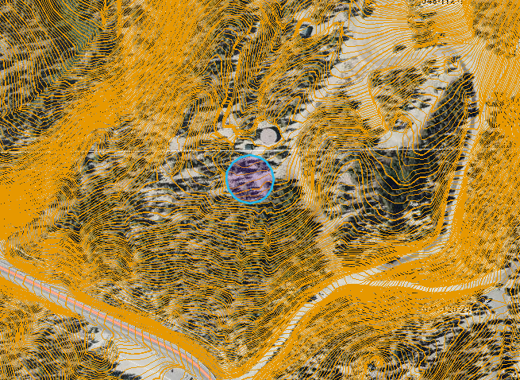
Proposed 5M Gallon Water Tank for improved snow making capability.
Good location for moderate slope.
Good location with existing utilities serving 0.5M gallon tank.
Tank location approximately 2 football fields off highway on USFS land
Tank hidden by existing forest.
Water Tank

Slide 7
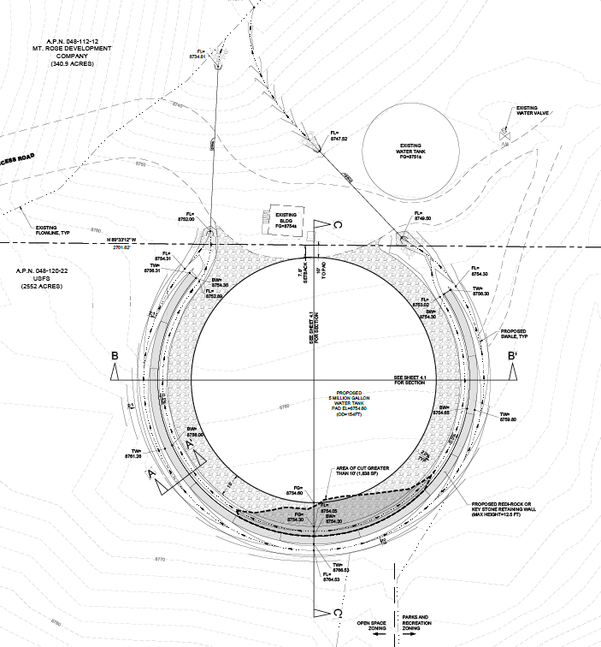
Proposed 5M Gallon Water Tank for improved snow making capability.
Benefit to achieve maximum snowmaking production during early season periods of ideal wet bulb periods.
Greater capacity allows for non-stop water for extended windows of opportunity
Goal to achieve consistent 6+ month ski seasons with ample terrain coming on-line, rapidly.
Note – comparison
  Mt. Rose 5M Gallon
  Heavenly – 60M Gallon
Water Tank

Slide 8
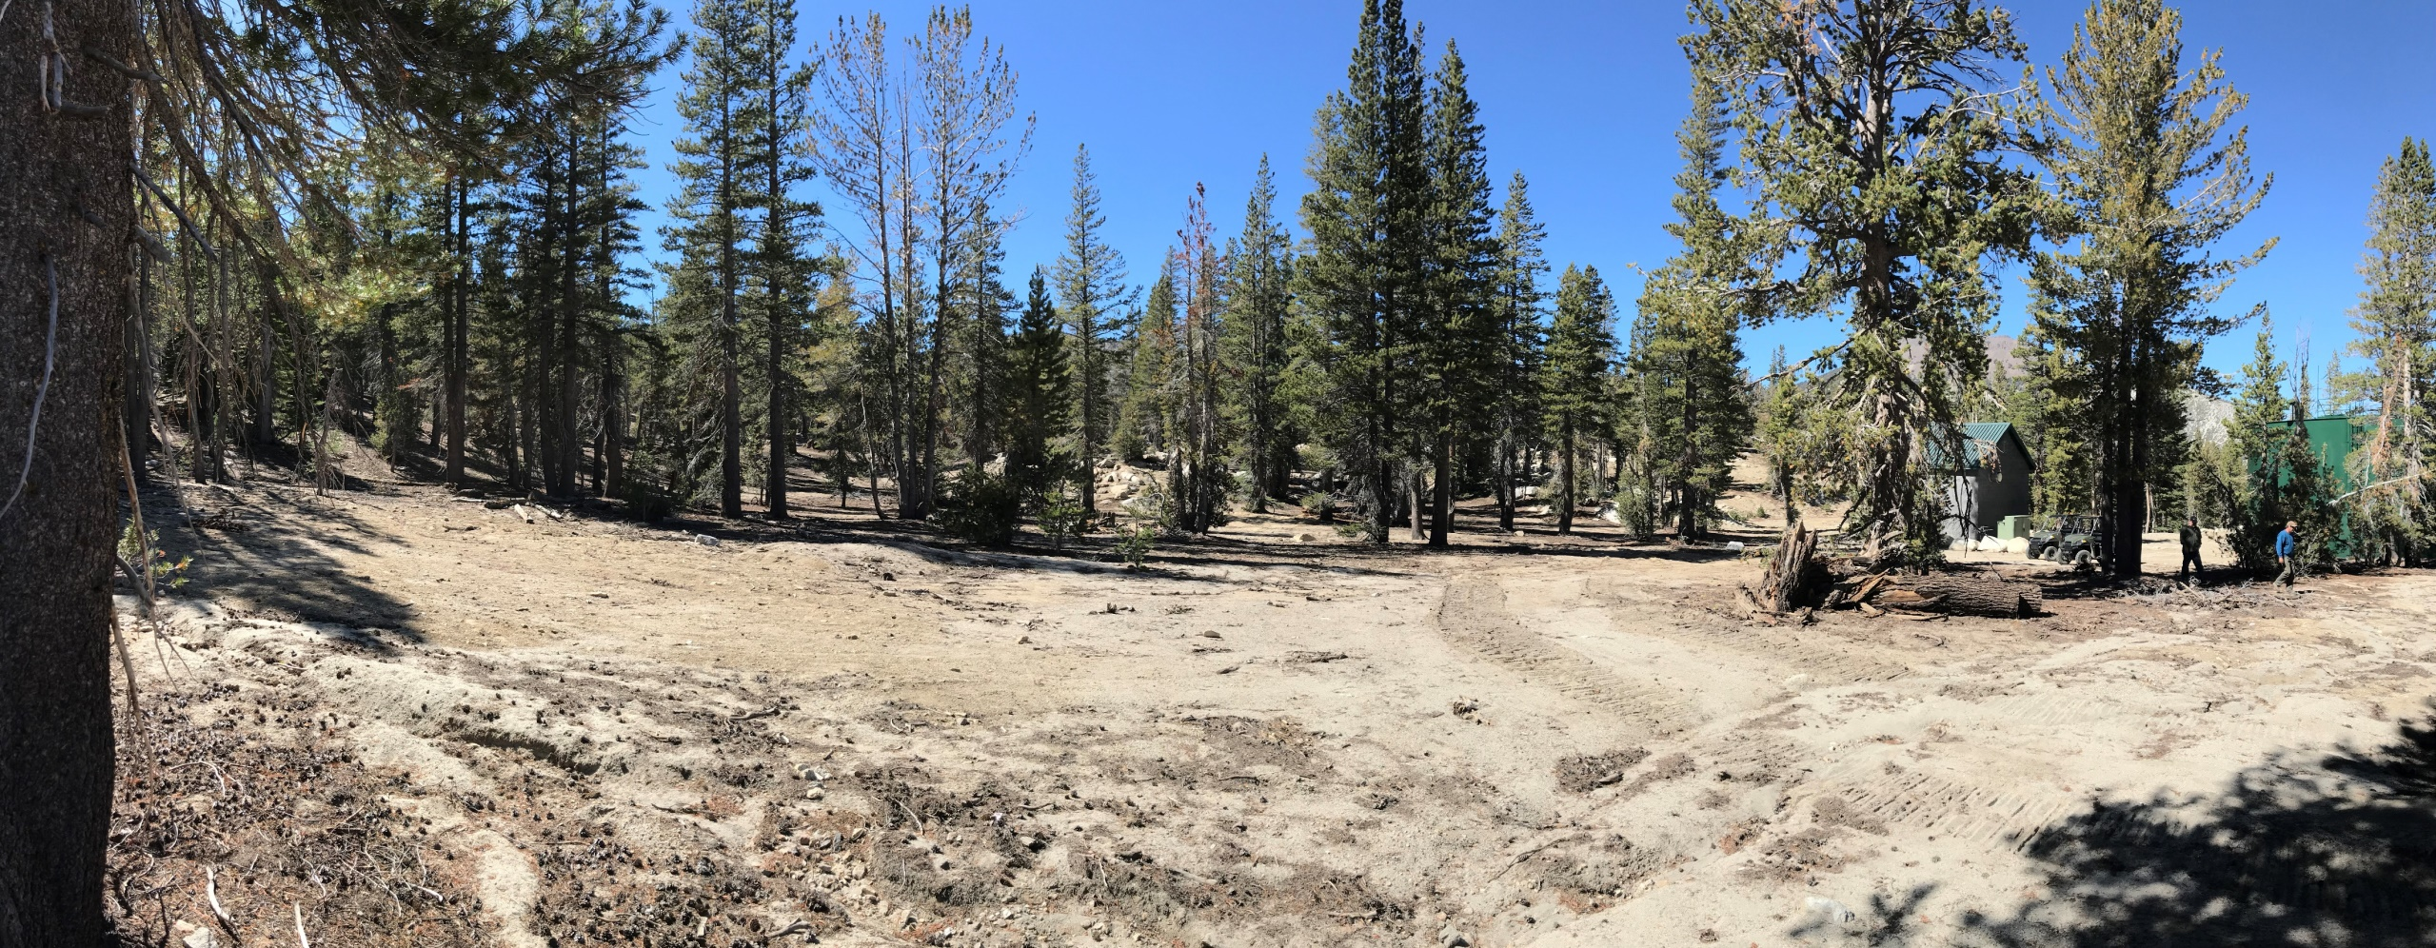
Water Tank Existing Site Conditions

Slide 9
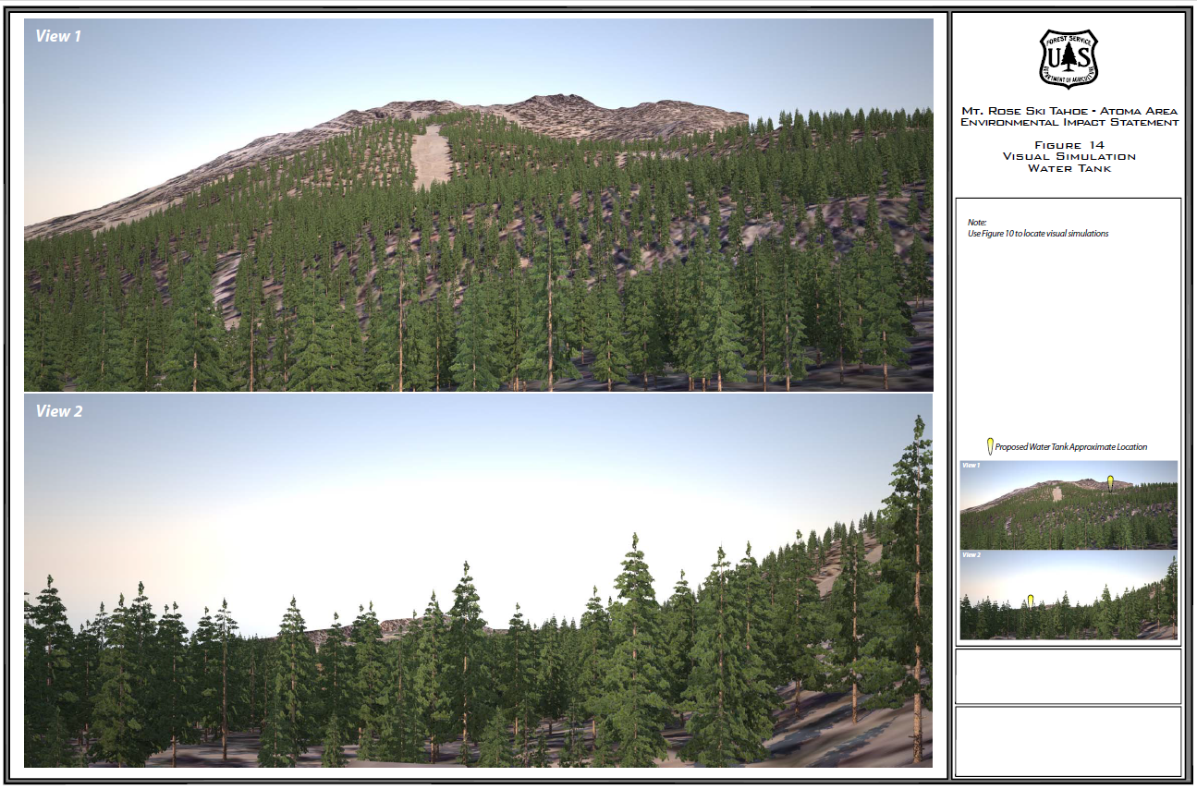
Water Tank Visual Simulation

Slide 10
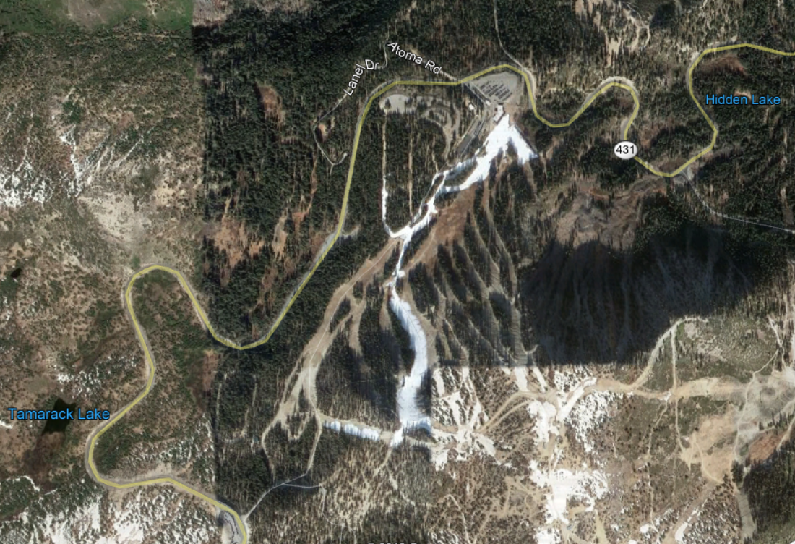
Early Season Snow Making Example (November 2018 Aerial)

Slide 11
The applicant believes that the proposed Water Tank addition to Mt. Rose Ski Tahoe allowed under the Washoe County Master Plan and Forest Area Plan-Mount Rose Resort Service Area and that all of the findings for approval can be made.
We agree with the Staff recommendations and the conditions of approval, as presented in the staff report for WSUP19-0021.

Slide 12
Questions

Slide 13
Extra Slides for Questions, If Necessary

Slide 14
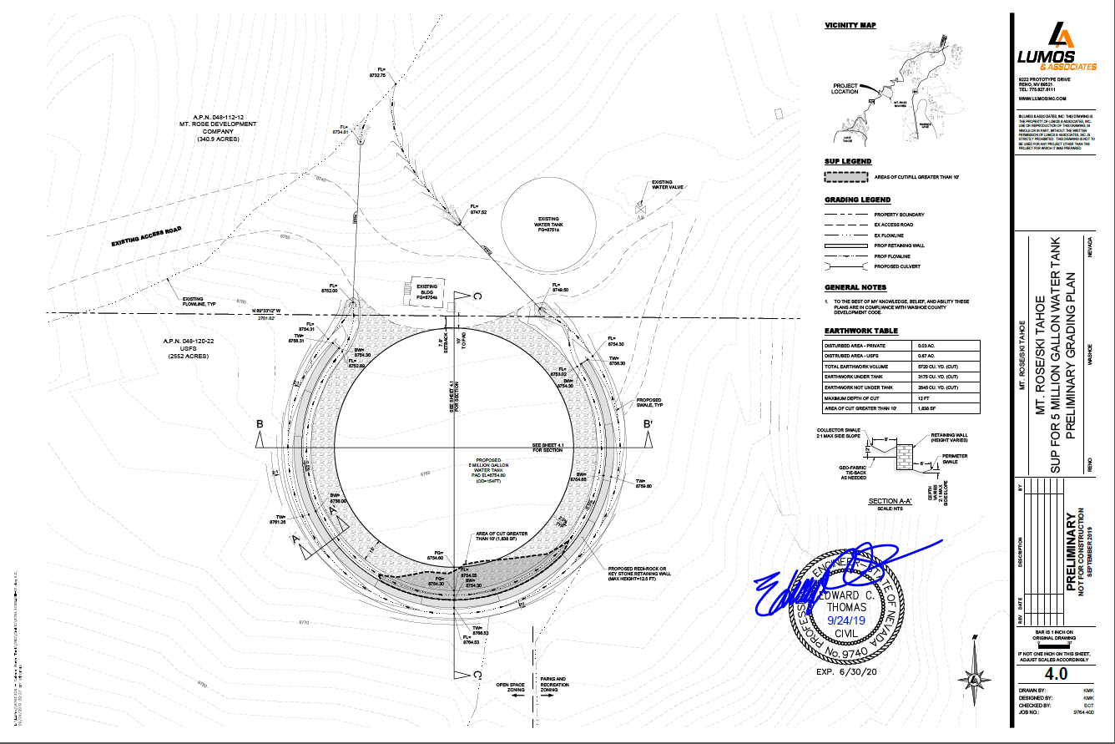

Slide 15
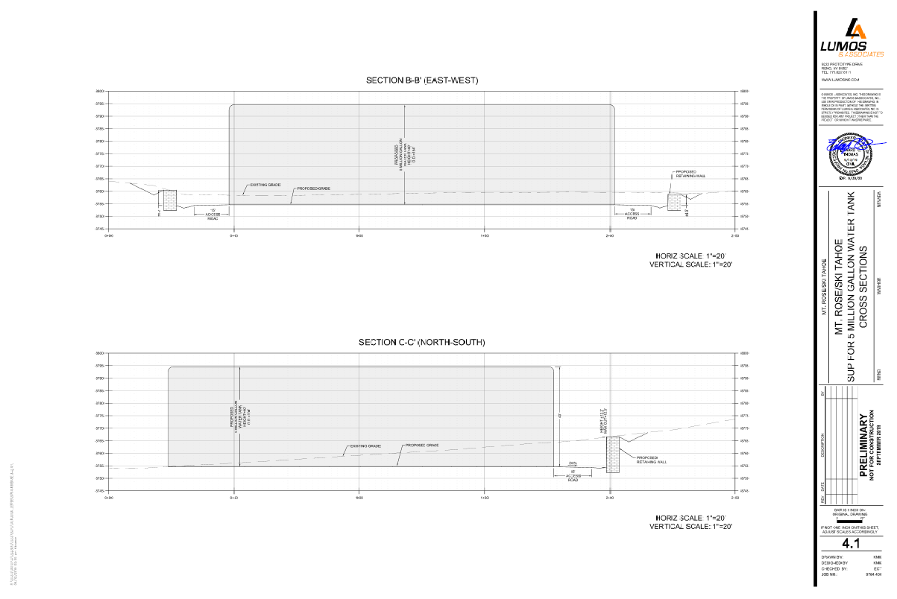

Slide 16
Other Area Ski Area Water Capacity Comparisons
Northstar 44 M
Alpine Meadows 8 M
Boreal 11 M
Sugar Bowl 43 M
Diamond Peak 5 M
Water capacities are provided in tanks and/or ponds.

